Slide 1
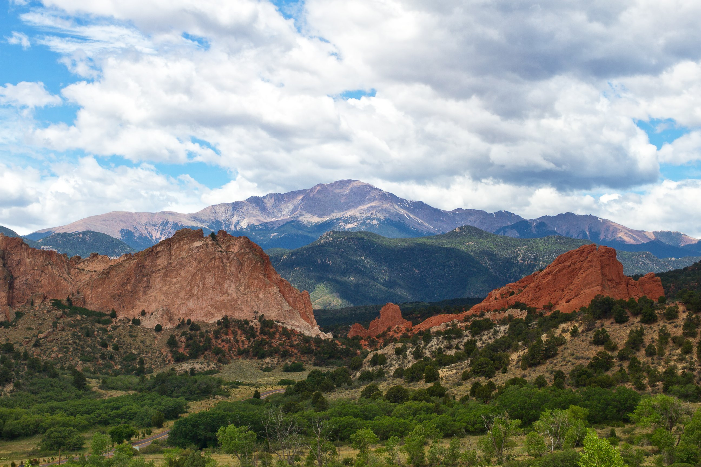

2023 Preliminary Balanced Budgets
El Paso County Public Improvement Districts
Nikki Simmons, CPA
Chief Financial Officer
Financial Services Department
October 4, 2022

Slide 2

El Paso County Public Improvement District
(PID) NO. 1
Financial Services Department

Slide 3
EPC PID No. 1
Financial Services Department

Slide 4
El Paso County Public Improvement District
(PID) NO. 2
Financial Services Department

Slide 5
EPC PID No. 2
Financial Services Department

Slide 6
El Paso County Public Improvement District
(PID) NO. 3
Financial Services Department

Slide 7
EPC PID No. 3
Financial Services Department

Slide 8
El Paso County Pioneer Village Roads Public Improvement District
Financial Services Department

Slide 9
Pioneer Village PID
Financial Services Department

Slide 10
El Paso County Stratmoor Valley Streetlight Public Improvement District
Financial Services Department

Slide 11
Stratmoor Valley Streetlight PID
Financial Services Department

Slide 12

Thank You

