Slide 1


2023 Preliminary
Balanced Budget
Nikki Simmons, CPA
Chief Financial Officer
Financial Services Department
October 4, 2022

Slide 2

Presentation Overview
Budget Process
2023 Preliminary Balanced Budget
  Revenues
    Property Tax
    Sales Tax
  Expenditures
    Critical Needs
Preliminary Balanced Budget Document
Financial Services Department

Slide 3
Budget Process
Compiling The 2023 Budget
Budget Process Policy:
Section 5.2 starts the annual budget process
  Restricted Funds, Partially Restricted Funds and Unrestricted Funds
Section 5.3 – 2023 Budget for Restricted Funds (Completed)
  Road and Bridge Escrow
  Conservation Trust Fund
  Household Hazardous Waste Fund
  Schools Trust Fund
  Local Improvement Districts
Financial Services Department

Slide 4
Budget Process
Compiling The 2023 Budget
Budget Process Policy:
Section 5.4 – 2023 Budget for Partially Restricted Funds (Completed)
  Community Investment Fund (CIP)
    Ensured funding for Annual Lease Obligations (COPs and Capital Leases)
  Self-Insurance Fund
    Ensured funding for anticipated insurance claims – Health & Risk
    Minor increase in health insurance premiums – covered by employer contribution, not passed to employees
    Includes Reserve for required GASB Fund Balance to address the “Incurred But Not Reported” (IBNR) claims - Actuarially Determined
    Includes Health Plan Trust Board approved changes
Financial Service Department

Slide 5
Budget Process
Compiling The 2023 Budget
Budget Process Policy:
Section 5.4 – 2023 Budget for Partially Restricted Funds (Completed)
  Department of Human Services
    Ensured funding for statutory county match
    State Fiscal Year 2022/2023 & estimated 2023/2024 Allocations
  Road and Bridge Fund
    On a multi-year plan to address backlog of road infrastructure
    Additional proposed funds of $10,000,000 (one-time)
Financial Services Department

Slide 6
Budget Process
Compiling The 2023 Budget
Budget Process Policy:
Section 5.5 – 2023 Budget for Unrestricted General Fund (In Process)
Revenue Estimates – Sales and Use Tax:
  Up 6.08% through July 2022 over 2021 (4% budgeted increase)
    “Retail” is up 4.31% (54.0% of budgeted revenue)
    “Food services” is up 8.61% (10.85% of budgeted revenue)
    “Wholesale trade” is up 7.45% (5.34% of budgeted revenue)
    “Accommodations” is up 28.19% (2.75% of budgeted revenue)
  The average increase over the last five years is 9.35%
  2022 estimated ending increase of 6% over 2021
  2023 PBB includes staff recommended increase of 4.0% over 2022 estimate
  2023 Sales and Use Tax preliminary budget is $172.8M
Financial Services Department

Slide 7
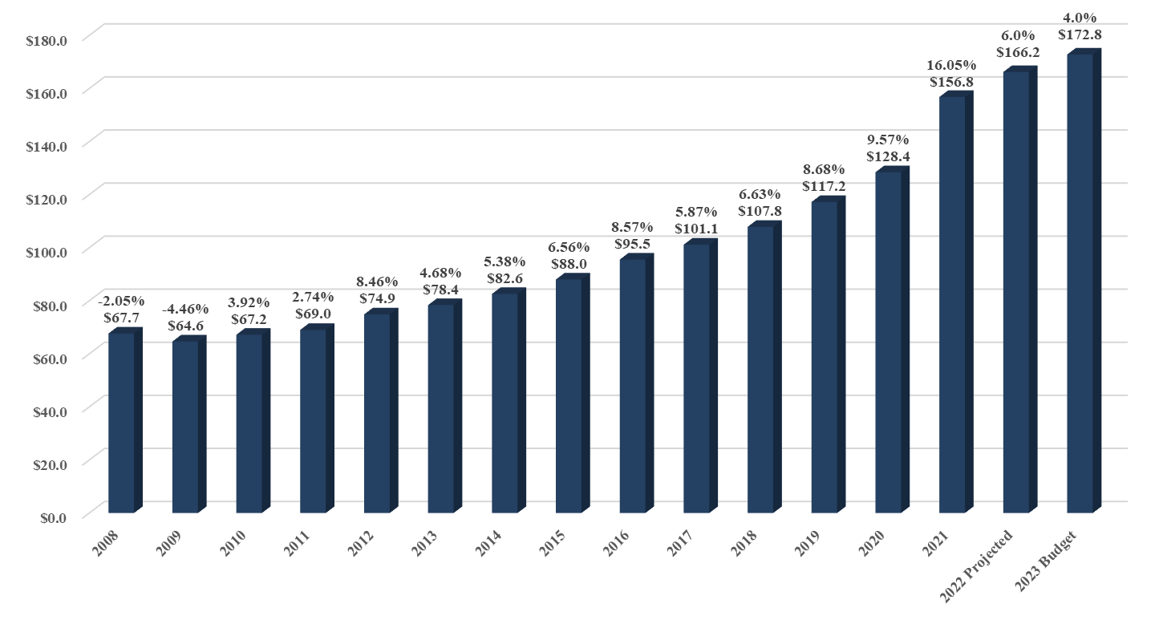
2023 Preliminary Balanced Budget
Sales & Use Tax (1%)- Projection(in Millions)
Financial Services Department

Slide 8
Budget Process
Compiling The 2023 Budget
Budget Process Policy: Section 5.5 (Continued)
Revenue Estimates – Property Tax:
Property Tax revenue increase of 8.4% to $74.6M
  Based on Preliminary Certification of Valuation
  Allowable abatement mill of 0.169 mills
  Estimated temporary mill levy reduction of 0.384 mills due to TABOR Property Tax Cap
    Estimated $13.34 for a $500,000 house
  Without temporary reduction, mill levy would be approximately 8.460 mills, with temporary reduction it is estimated at 8.077 mills
Financial Services Department

Slide 9
Budget Process
Compiling The 2023 Budget
Budget Process Policy: Section 5.5 (Continued)
Revenue Estimates – Property Tax:
Property Tax – TABOR
  In addition to Property Tax Temporary Mill Levy Reduction, 2023 Property Tax bills will have estimated 3.251 mill property tax credit for 2021 TABOR overage of $30,682,117
    Estimated $113 for a $500,000 house
Net 2023 Property Tax Revenue after 2021 Refund is $45.1 Million
Financial Services Department

Slide 10
2023 Property Taxes
Financial Services Department

Slide 11
Budget Process
Compiling The 2023 Budget
Budget Process Policy: Section 5.5 (Continued)
Revenue Estimates – Property Tax:
Growth in Property Tax is constrained by 5.5% mill levy law and TABOR.
Allows for property valuation growth to be higher than growth in property tax.
Financial Services Department

Slide 12
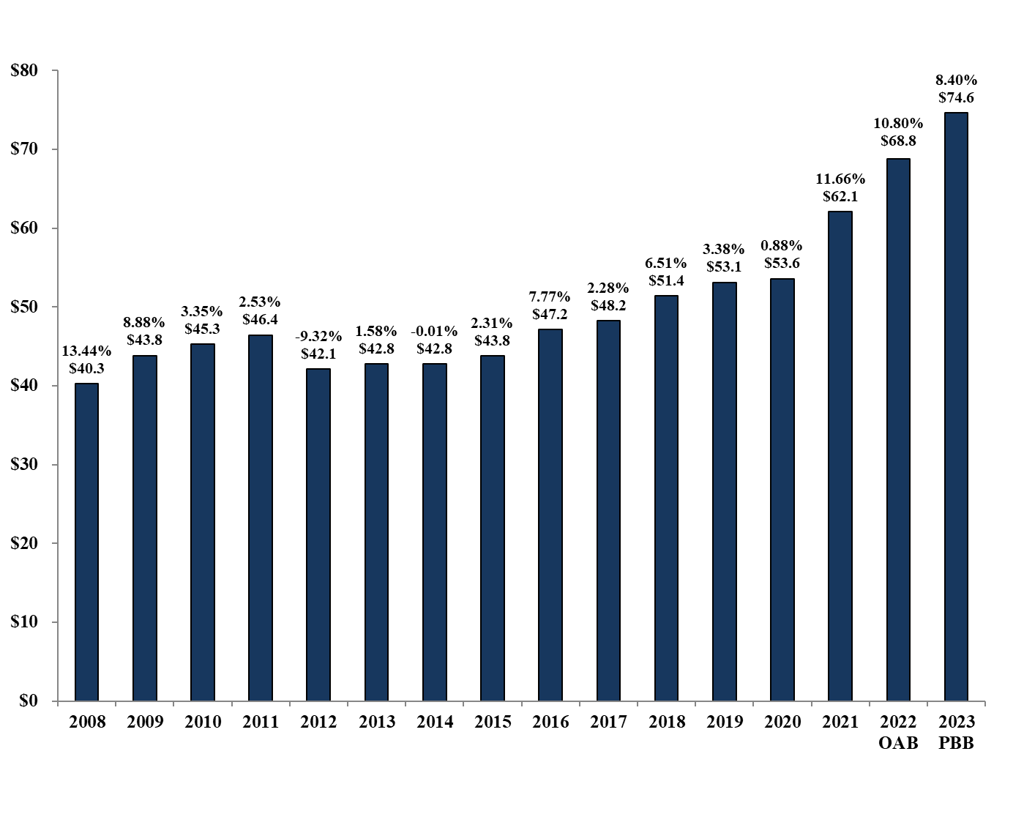
2023 Preliminary Balanced Budget
Property Taxes- All Funds (in Millions)
Financial Services Department

Slide 13
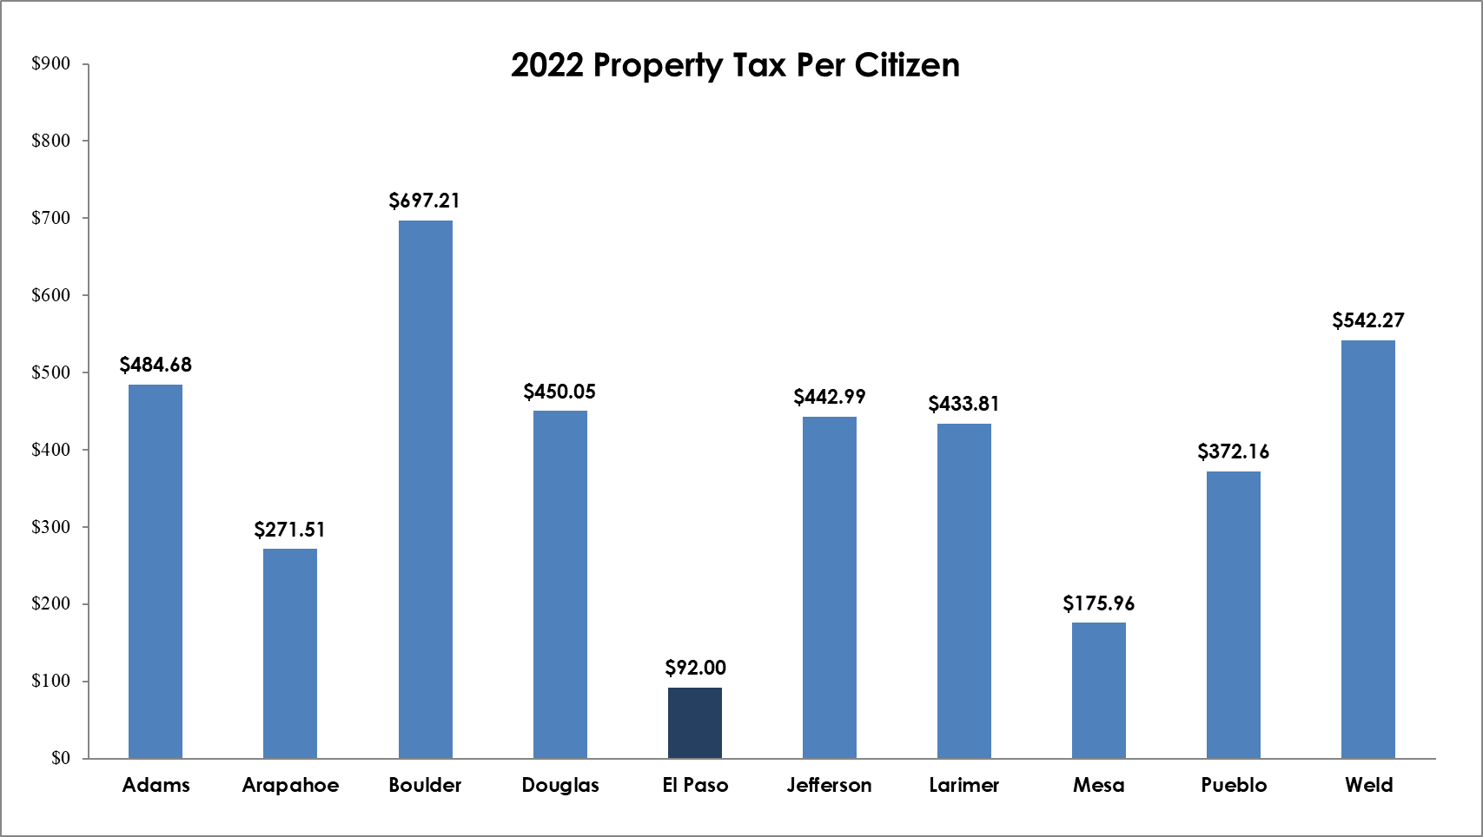
2023 Property Tax Per Citizen
10-County Comparison
Financial Services Department

Slide 14
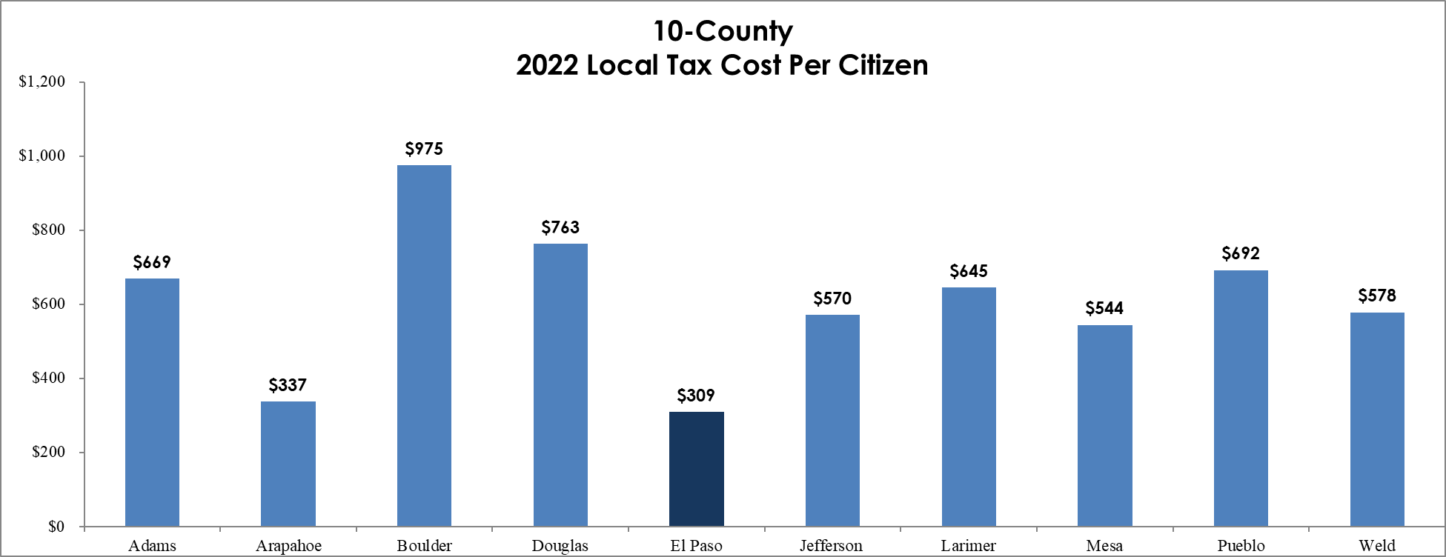
2023 Total Local Tax Per Citizen
10-County Comparison
Financial Services Department

Slide 15
Budget Process
Compiling The 2023 Budget
Budget Process Policy: Section 5.5 (Continued)
Revenue Estimates – Other Revenue Lines:
    Changes from 2022 budget to 2023 budget:
    Clerk & Recorder Fees - $650K
    Planning & Community Development Fees - $395K
Financial Services Department

Slide 16
Budget Process
Compiling The 2023 Budget
Budget Process Policy: Section 5.5 (Continued)
2023 Expenditure Budgets
  Retain 2022 Expenditure Base Budget
  2023 Beginning Operational Savings of $14.7M (essentially the “spendable” fund balance)
  Strategy Phase of the budget (5.5.3.2), meetings held with Countywide Elected Officials and Department Executive Directors
Financial Services Department

Slide 17
Budget Process
Compiling The 2023 Budget
Re-evaluated critical needs due to increased service demands, population growth, and mandated pressures
Investment in Human Capital Management
  Recommending 5% increase for COLA and 2% allocation of personnel budgets for departments and offices for equity adjustments
  Additional reserved for market adjustments to be allocated based on comprehensive salary study
  CPI is currently projected to be approximately 8.2% for 2022
Financial Services Department

Slide 18
Budget Process
Compiling The 2023 Budget
  County Road Projects
    2023 budget increases funding for road projects at $10 million (one-time)
    Allows Department of Public Works to strategically address highest priority road projects
Financial Services Department

Slide 19
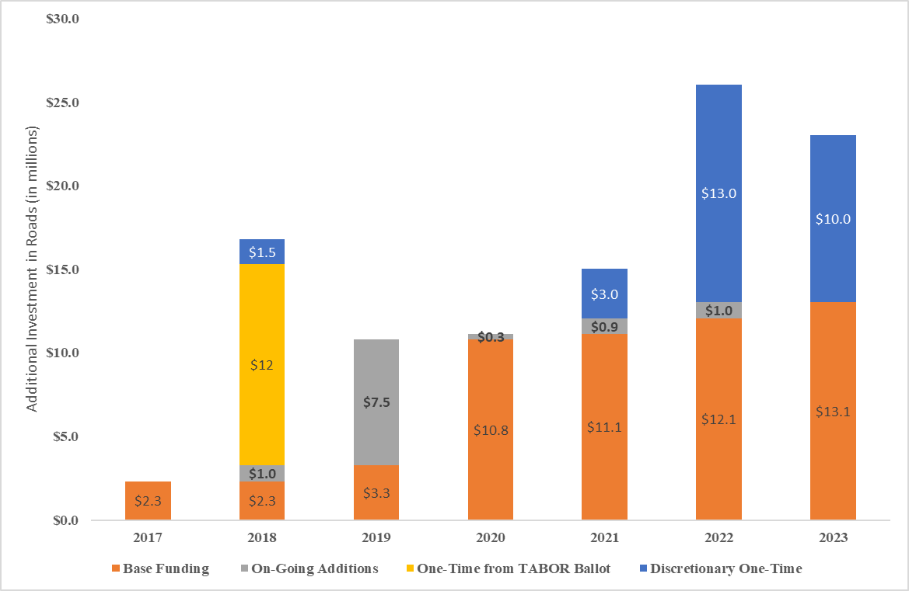
Budget Process
Annual Additional Investment in Roads
Financial Services Department

Slide 20
Budget Process
Compiling The 2023 Budget
  TABOR Calculation Impacts - PRELIMINARY
    Early estimates (through August) show significantly above TABOR Cap
    TABOR calculation very preliminary – numerous variables can drastically change before finalized in about 6 months:
      CPI Increase – June estimates will change several times by Feb/Mar 2023
      Growth calculation – Using August preliminary – not finalized until December 2022 with final Certification of Valuation
      Sales Tax and Intergovernmental impacts have been increasing
      2022 Estimates – $30M reserved for TABOR overage
    Staff is closely monitoring TABOR revenues
Financial Services Department

Slide 21
Budget Process
Compiling The 2023 Budget-Emergency Reserve
2023 Budget assumes being at County’s TABOR revenue cap, all excess revenues kept in reserve for future consideration or refund
$5,000,000 Emergency Reserve – no plans to spend into this fund balance
$3,000,000 recommended addition to reserves through the 2023 preliminary balanced budget
Additional reserves
  Minimum fund balance policy
  10% of General Fund Sales Tax, 0.5% Property Tax, and 5% all other revenues
  Minimum Fund Balance of $19.6 million for 2023
  Estimated TABOR 3% Reserve of $9.8 million
Financial Services Department

Slide 22
PBB & The Strategic Plan
Financial Services Department

Slide 23
Critical Needs Addressed in the 2023 PBB
Infrastructure
Financial Services Department

Slide 24
Critical Needs Addressed in the 2023 PBB
Infrastructure
Financial Services Department

Slide 25
2023 Preliminary Balanced Budget Document
Financial Services Department

Slide 26
2023 Budget Process
Financial Services Department

Slide 27

Questions?

